Slide 1






















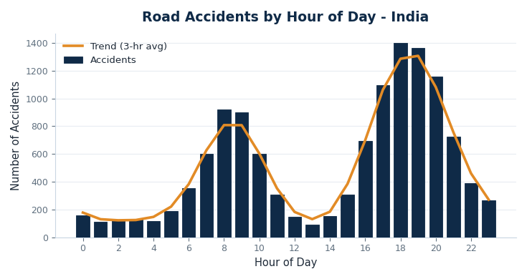
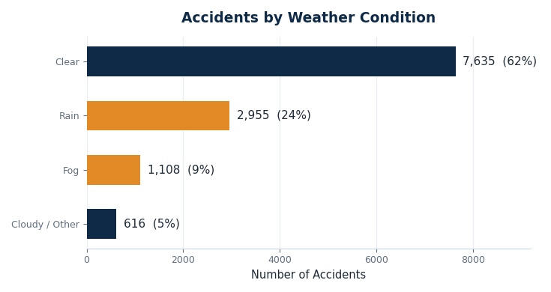






EXPLORATORY ANALYSIS OF ROAD ACCIDENT DATA
TO IDENTIFY RISK FACTORS
Name: Shaik Nuha Reg.no:192472242
Code:DSA0404
1
INTRODUCTION
Road traffic accidents remain a major public safety concern, arising from a complex interplay of driver behaviour, road conditions, vehicle type, weather and time of travel. Exploratory data analysis helps uncover the patterns behind these factors and highlights where interventions can have the greatest impact. By identifying common patterns and high-risk factors, this analysis can provide useful insights for improving road safety, supporting better traffic management, and helping authorities develop effective accident-prevention strategies.
5 YEARS
12,314
6 FACTORS
Study period covered (2019–2023)
Accident records analysed
Risk dimensions examined per record
PROBLEM STATEMENT
OBJECTIVES
Road accidents arise from a complex mix of driver behaviour, weather, road type, junction design and time of travel.
Without a clear view of which conditions carry the greatest risk, prevention efforts are difficult to prioritise effectively.
Analyse historical road accident records
Compute descriptive and severity statistics
Examine accidents by time, weather and road type
Identify the key risk factors influencing severity
Translate findings into actionable safety recommendations
2
DATASET & STUDY DETAILS
DATASET
REGION
VARIABLE
OBSERVATIONS
SOURCE
Road Accidents
(2019–2023)
Pan-India
Accident severity
12,314
Kaggle Road
Accident Dataset
Each record captures the accident date, time, weather condition, road type, junction category, vehicle class and injury severity. This multi-field structure allows the dataset to be sliced along several dimensions at once, supporting a broad exploratory analysis rather than a single-variable summary.
3
ARCHITECTURE / METHODOLOGY
KAGGLE DATA
›
SELECT REGION
›
PREPROCESS
›
STATISTICS
›
RISK FACTORS
›
COMPARE
Historical
accidents
Pan-India
Remove missing
& duplicates
Frequency,
severity rates
Time • weather
road type
Charts
& insights
Raw records were first cleaned to remove duplicates and incomplete entries, then aggregated by hour, weather condition, road type and junction category. Descriptive statistics and cross-tabulations were used to surface the variables most strongly associated with accident frequency and severity, which were then visualised for comparison.
4
KEY RISK FACTORS IDENTIFIED
+
TIME OF DAY
WEATHER CONDITIONS
ROAD & VEHICLE TYPE
JUNCTIONS &INTERSECTIONS
28% between 5–7 PM
2.1x severity in rain / fog
3x fatality rate on highways
41% of urban accidents
Evening rush hour records the highest share of accidents; night-time crashes tend to be the most severe due to reduced visibility.
Rain and fog sharply raise accident risk despite carrying much less overall traffic than clear days.
Highways see fewer accidents overall but far higher fatality rates than busier, congested urban roads.
Unsignalled intersections and poor lane discipline make junctions a major hotspot within city limits.
5
RESULTS — ACCIDENT DATA ANALYSIS
OBSERVATIONS
FATAL RATE
SERIOUS INJURY
PEAK HOUR
TOP RISK FACTOR
12,314
15.0%
33.7%
6 PM
Rain / Fog
Accidents by Hour of Day
Accidents by Weather Condition
STATISTICAL RESULTS
KEY OBSERVATIONS
Total accidents: 12,314
Fatal: 1,847 (15.0%) • Serious injury: 4,150 (33.7%) • Minor injury: 6,317 (51.3%)
Peak accident hour: 6 PM (18:00) Lowest accident hour: 3 AM (03:00)
Highest-risk weather: Rain / Fog Average per day: ~34 accidents
Urban roads carry 58% of accidents; highways account for 42% but record the highest fatality rate per accident. Evening rush hour and adverse weather compound risk — rain combined with peak traffic shows the sharpest spike in severity. Junctions without signals contribute a disproportionate share of urban collisions.
6
CONCLUSION & RECOMMENDATIONS
CONCLUSION
RECOMMENDATIONS
The analysis of 12,314 road accident records shows that risk is concentrated in specific, identifiable conditions. Evening rush hour, rainy or foggy weather, and highway travel are each linked to a disproportionate share of severe accidents, while unsignalled urban junctions add further risk.
Weather-based speed advisories
Junction engineering
Lower speed limits automatically during rain and fog.
Add signals and clearer lane markings at high-risk intersections.
Evening awareness campaigns
Faster emergency response
Target driver-alertness messaging around the 5–7 PM rush.
Prioritise ambulance dispatch on high-fatality highway stretches.

